Slide 1








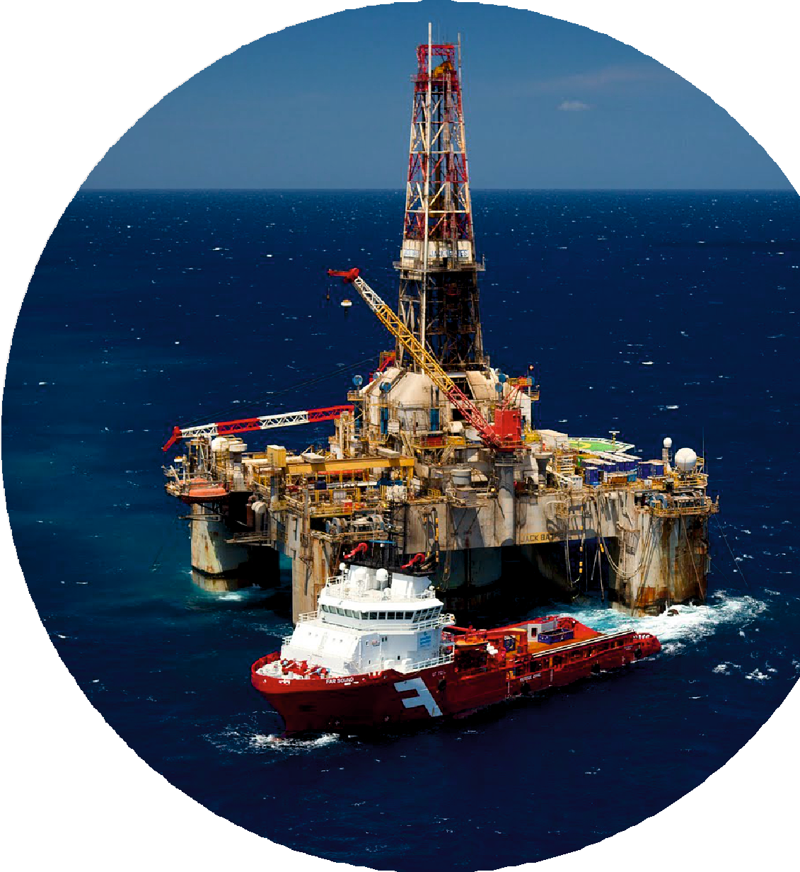
A Thriving Industry,
Invest in Your Future in
OIL&GAS
COCHIN | BENGALURU

Slide 2


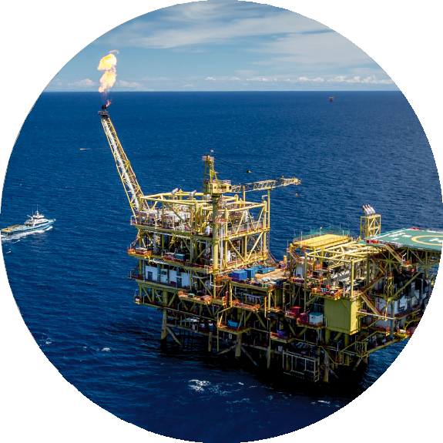
Introduction
Diploma in oil and gas rig technology is a program designed to provide students with the technical knowledge and practical skills required to work in the oﬀshore/onshore oil rigs. The curriculum usually consists of a combination of classroom lectures, safety training, rig training and hands-on training on equipment commonly used in the oil and gas industry.
Some of the speciﬁc courses that students may take in a diploma program in oil and gas rig technology include drilling technology, well completion, production operations, safety and environmental practices . Students may also have the opportunity to participate in ﬁeld trips and internships to gain practical experience and apply what they have learned in real-world settings. Upon graduation, diploma holders in oil and gas rig technology may ﬁnd employment opportunities in a range of roles such as drilling technicians, production operators, rig supervisors, or safety specialists, can expect to work in various settings, including oﬀshore and onshore rigs
“More than 500+ candidates from Blitz Academy got selected and presently working various Oil Rig around the world”
www.blitzacademy.org

Slide 3

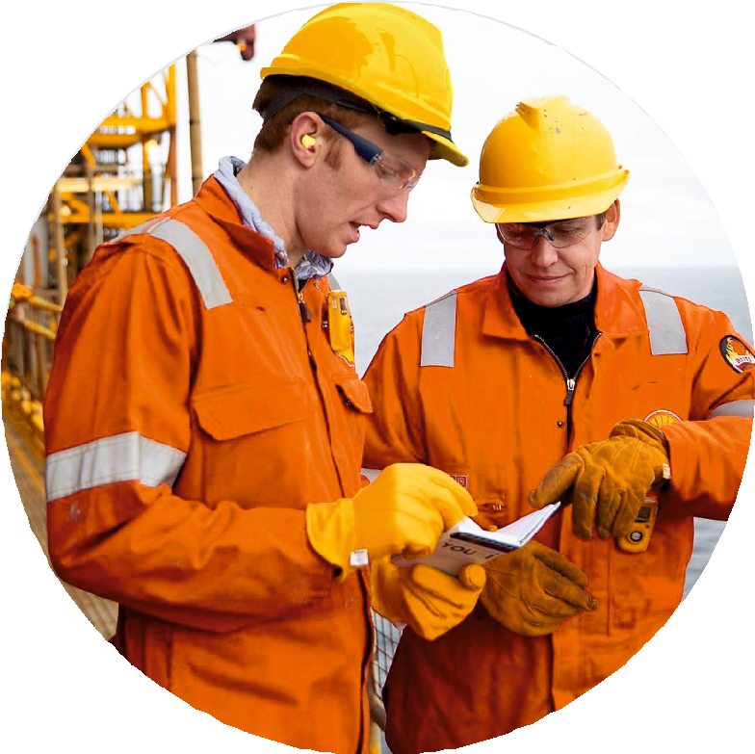

Why Choose Oil & Gas Rig Technology
Job security - The oil and gas industry is a major contributor to the global economy, and there is a constant demand for skilled workers in this ﬁeld. This means that those with a diploma in oil and gas rig technology can expect to have good job security, with opportunities for long-term employment.
High earning potential - Workers in the oil and gas industry are typically well-compensated for their work, with salaries that are often higher than the average for other industries. This can make pursuing a career in oil and gas rig technology an attractive option for those looking to earn a good income.
Opportunity for travel - Many oil and gas rig workers have the opportunity to work in different parts of the world, which can be an exciting prospect for those who enjoy traveling and experiencing new cultures.
Hands-on work - Working on an oil and gas rig can be physically demanding, but it can also be rewarding for those who enjoy working with their hands and solving problems.
Opportunities for advancement - The oil and gas industry offers a variety of opportunities for career advancement, with many workers starting out as entry-level technicians and working their way up to management positions.

Slide 4
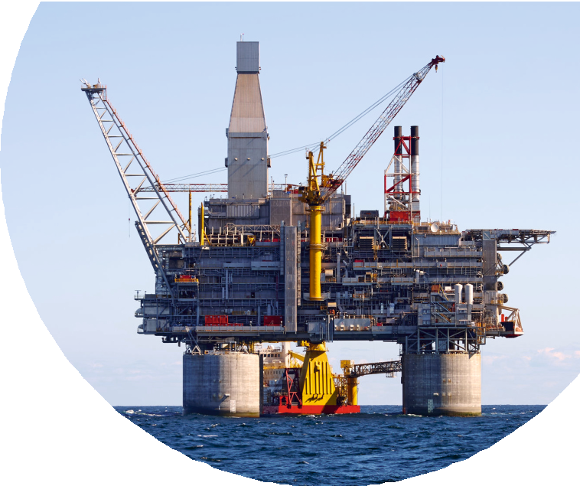
What We Provide?
Characteristics of Oil and Gas
Exploration, Surveys and Drilling Rights Drilling Rigs and Drilling a Well Exploration and Development Drilling Production and Work-over
Safety Trainings Final Assessment
www.blitzacademy.org

Slide 5

Rig Safety Certiﬁcations We Provide
STCW
International convention on standards of training, certiﬁcation and watch keeping-Directorate general of shipping (Government of INDIA)
STSDSD
Security training for seafarers with designated security duties
HUET
Helicopter underwater escape training
BOSIET
Basic offshore safety induction and emergency
H2S
Hydrogen Sulphide Trainings.

Slide 6

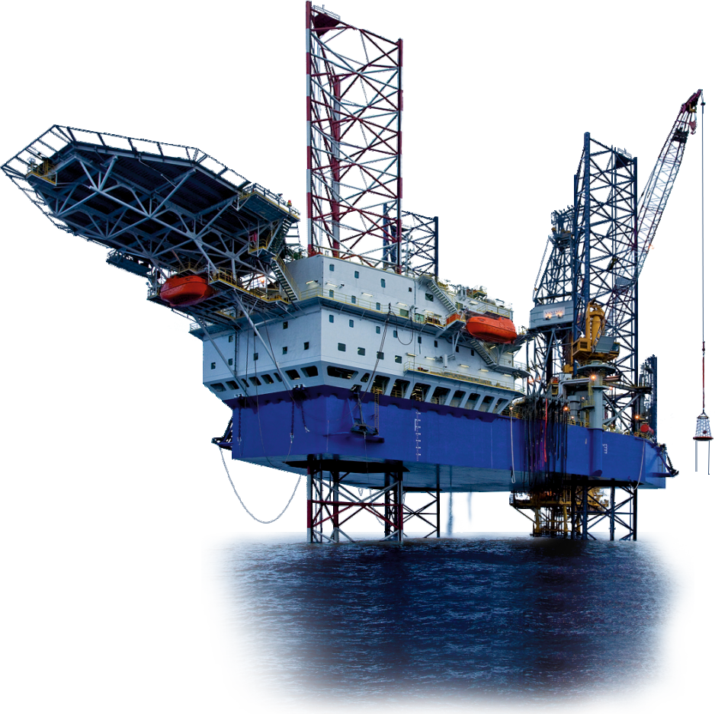

Program Structure
Lecture - Theory class
Drilling and other aspects in Oil and Gas (BOP/SSV/Well Head Control Operation, Oil & Gas Production in On-Shore/Off-Shore, Petroleum Exploration Techniques, Horizontal/Directional/Smart Drilling, Gas Processing, Oil Production Station, Process safeguarding etc.
General Engineering awareness, Mechanical QA/QC, Piping Design Engineering and Construction etc. (Pipe Supports & Stress Analysis, Statutory Regulations & Safety Aspects, Fabrication, Testing & Installation, Costing & Piping Systems
Rig Training
Rig training gives a preliminary knowledge into the various stages of oil exploration, production, drilling reﬁnery processes and conﬁguration. It contains the upstream, midstream and downstream processes convening operational methods in oil exploration and details offshore, onshore and rig safety on Oil and Gas ﬁelds

Slide 7
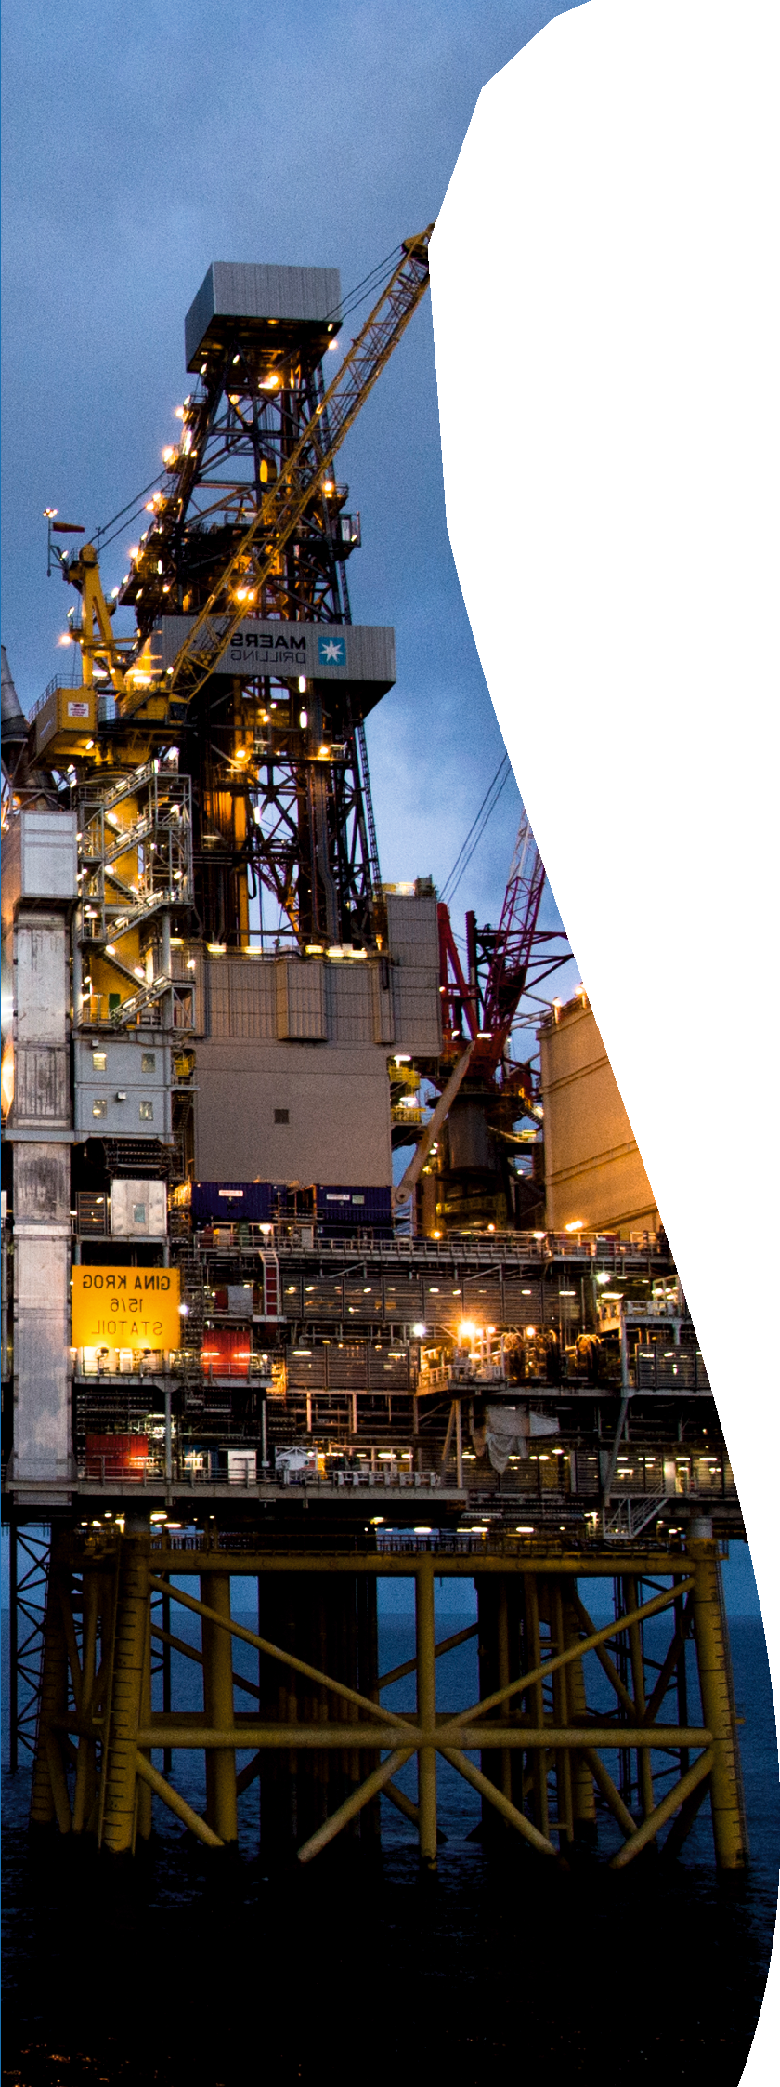
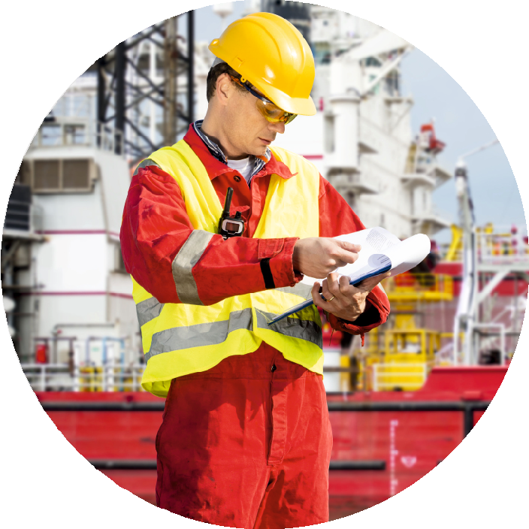
Careers in Oil Rig
Roustabout Floor Hand / Floor Man
Derrick Man
Driller Mechanic Electrician Safety Coordinator
Rig Manager Maintenance Supervisor
HSE Manager Control Systems Technician Oilﬁeld Service Operator Construction Superintendent

Slide 8

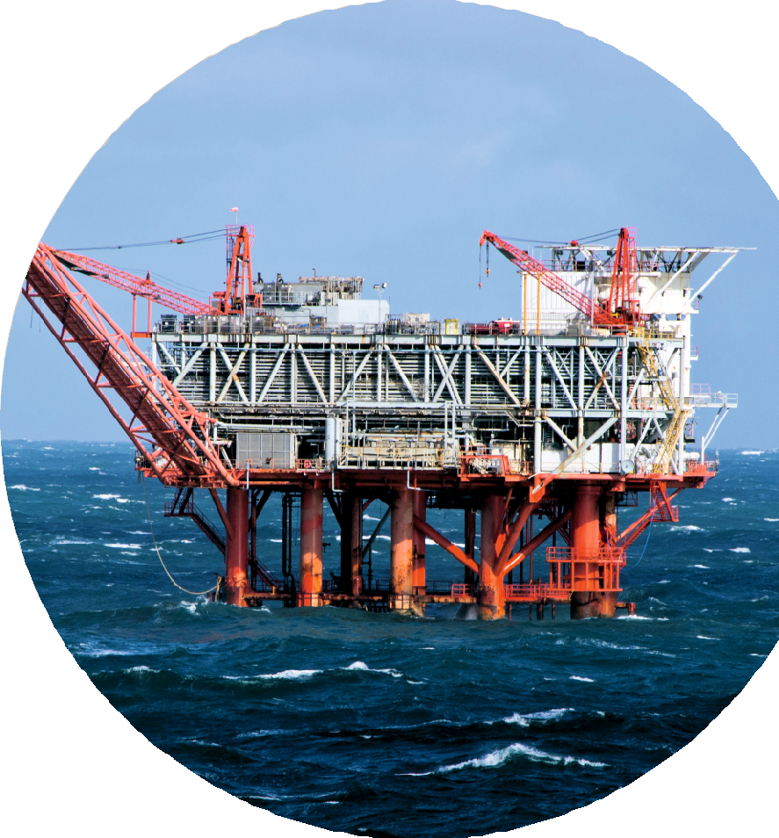


BANGALORE
CORPORATE OFFICE - 3rd Floor, No.48, 100 Feet Road, Near Sony Signal 4th Block, Koramangala, Banglore-560034
ERNAKULAM
MG ROAD - Perumpillil Building, Mahatma Gandhi Rd, KPCC Junction Opp Maharaja's Ground, Ernakulam, Kerala 682011
ERNAKULAM NORTH - 41/2553-D, 2nd Floor Metro Palace, Opp.North Railway Station, Ernakulam 602018
+91 9061 106 007, 9061 903 007
info@blitzacademy.org
www.blitzacademy.org

